Slide 1
Surveying Inequalities between Women and Men in Metropolitan and Overseas France using INSEE Data
Phileas Dazeley Gaist – COA Biostatistics Spring 2021

Slide 2
Statement on Nomenclature
Gendered terms
Age groups
Socioprofessional groups
Metropolitan and Overseas France (DOM)
*INSEE: Institut National de la Statistique et des Etudes Economiques
Notes:
Nomenclature and language used in this presentation conforms to the official nomenclature designated by INSEE.
Socioprofessional groups = [cadres = execs, professions intermediaires = intermediary professions, employes = employees, ouvriers = workers (working class)]

Slide 3

The Data
Net wage gap between men and women (2017) (%)
Formula = (w net hourly salary – m net hourly salary)/m net hourly salary
by: age groups, socioprofessional groups, total
Total rate of monetary poverty of individuals (2017) (%)
Intensity of poverty (2017) (%)
Differences in rates of employment of women and men in official positions in municipalities (2021) (%)
Differences in rates of average ages at first child between women and men (2019) (%)
Notes:
Describe the data sets (show that the formula means most values will be “how much % women are underpaid by when compared to men)
Describe source: INSEE and context of data collection
Two data set sources:
Indicateurs régionaux de développement durable (French regional sustainable development indicators) (INSEE, accessed 04/2021):
Indicateurs régionaux sur les inégalités entre les femmes et les hommes (French regional indicators on inequalities among women and men) (INSEE, accessed 05/2021)

Slide 4
Project Summary, an examination of:
Wage gap by age group and region
Wage gap by socioprofessional group and region
Ordination of observations of inequality-marker variables between women and men

Slide 5
Is there a difference in the recorded wage gap between women and men in different age groups in 2017 between metropolitan France and the DOM?
(two-way ANOVA)
Notes:
Using wage gap w-m (2017) by region + age group
Meeting two-way ANOVA assumptions:
- Continuous dependent variable = wage gap %
Two independent categorical variables = region and age group
Samples are independent
As we’ll see in the boxplot slide, the variances of data groups are approximately equal
Given the distribution of the data and the nature of the variables it is safe to assume that each sample is taken from a normally distributed population

Slide 6
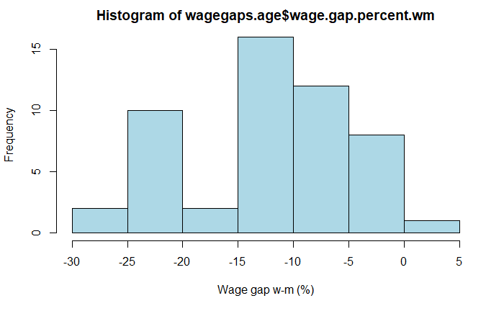
Notes:
Wage gap variable is sufficiently normally distributed

Slide 7
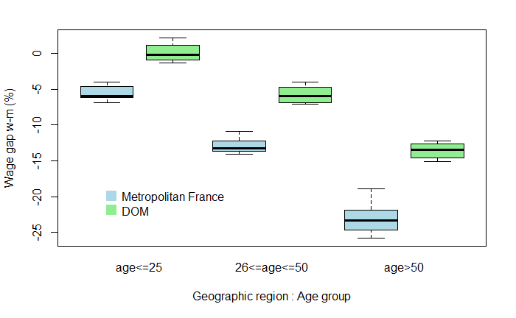
Notes:
- Homogeneity of variances in different groups
- Two apparent trends: wage gap is higher in metropolitan France, and wage gap is higher in older age groups, highest in the above 50 category

Slide 8
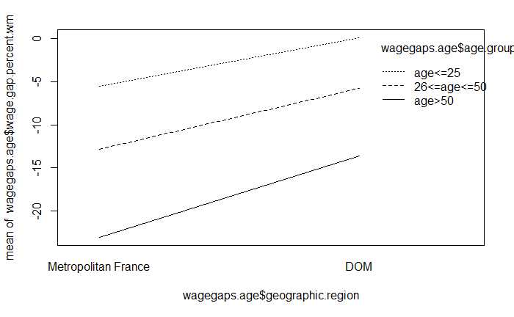
Notes:
On this interaction plot, there is no apparent interaction between variables
(possible exponential interaction = line slopes differ)

Slide 9
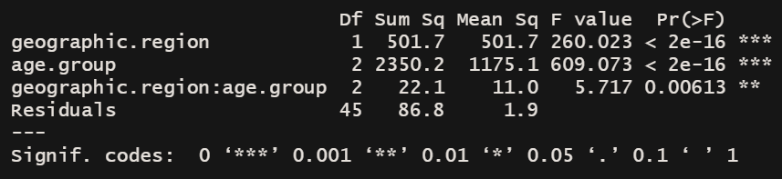
Results:
A two-way ANOVA (table below) revealed a significant effect of geographic region (P < 0.01) and age group (P < 0.01) on wage gap % between women and men, but with a significant interaction between geographic region and age group (P < 0.01). Observations in age group age>50 in Metropolitan France yielded higher wage gap results than expected when compared to the values found in other age group observations.
Notes:
# Null hypotheses:
# H0_1: there is no main effect of factor A
# H0_2: there is no main effect of factor B
# H0_3: there is no interaction between factors A and B (rejected)
Not going to go into too much detail about the TukeyHSD test results because of limited time + it’s a bit excessive

Slide 10
Is there a difference in the recorded wage gap between women and men in different socioprofessional groups in 2017 between metropolitan France and the DOM?
(two-way ANOVA)
Notes:
Using wage gap w-m (2017) by region + socioprofessional groups
Meeting two-way ANOVA assumptions:
- Continuous dependent variable = wage gap %
Two independent categorical variables = region and age group
Samples are independent
As we’ll see in the boxplot slide, the variances of data groups are less homogenous, which could affect the reliability of test results, but are close enough that I still conducted the test
Given the distribution of the data and the nature of the variables it is safe to assume that each sample is taken from a normally distributed population

Slide 11
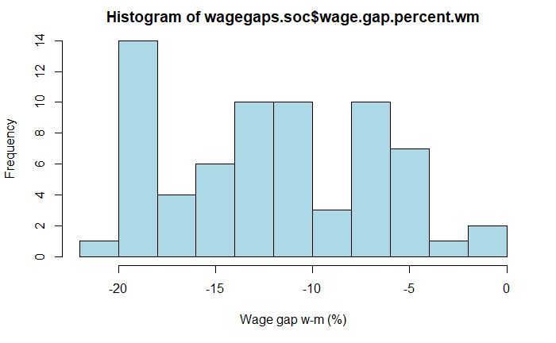
Notes:
Wage gap variable is sufficiently normally distributed

Slide 12
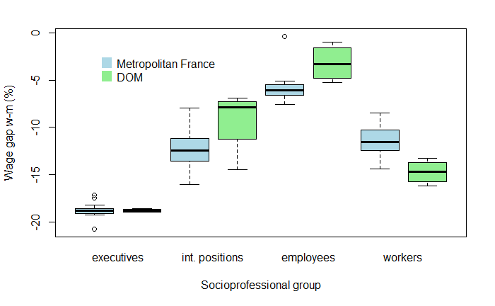
Notes:
- less homogeneity of variances in different groups
Trends are less apparent and there are signs of potential interaction between variables
Next slide is a closer look at the executives boxplot which is hard to see from this plot

Slide 13
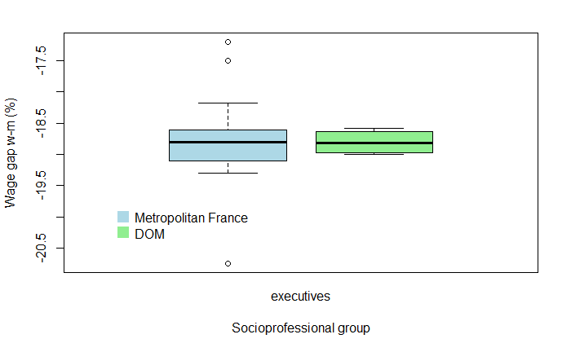

Slide 14
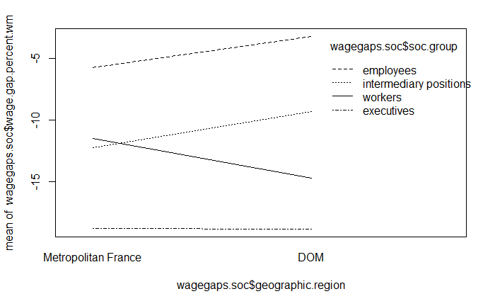
Notes:
On this interaction plot, there is an apparent interaction effect for some groups between geographic region and socioprofessional group on wage gap %
Interaction effect bw workers and other groups, and between executives and other groups
(antagonistic interaction = lines cross)

Slide 15
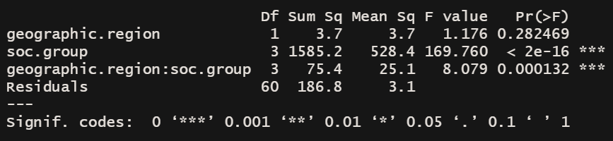
Results:
A two-way ANOVA (table below) revealed a significant effect of socioprofessional group (P < 0.01) but not geographic region (P = 0.28) on wage gap % between women and men, but with a significant interaction between geographic region and socioprofessional group (P < 0.01). In Metropolitan France, observations of workers showed yielded lower wage gap values when compared to DOM observations, for employees and intermediary positions the effect was reversed (interaction plot on slide 14)."
Notes:
# Null hypotheses:
# H0_1: there is no main effect of factor A
# H0_2: there is no main effect of factor B
# H0_3: there is no interaction between factors A and B (rejected)

Slide 16
Ordination of inequality-marker variables between women and men for regional observations in Metropolitan France and the DOM
(An NMDS approach)
Notes:
NMDS required some data preparation which included
Shifting the data to contain no negative values (appropriate because the variable scores in NMDS are unaffected and required to fulfil assumptions of NMDS appropriate data)
Standardising the data
Inverting the data for w-m datasets to force vectors to convey the inequalities facing women (where are women more disadvantaged?)
Inequality marker variables = age at first child gap, wage gap, employment gap in official positions in municipalities, rate of monetary poverty, intensity of poverty

Slide 17
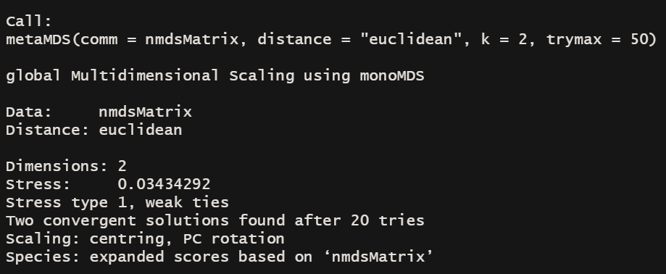
Notes:
NMDS method used = vegan library metaMDS (good for non biological data ordinations)
Two NMDS dimensions in ordination space
Stress = 0.03 (quite good, appropriate for test)

Slide 18
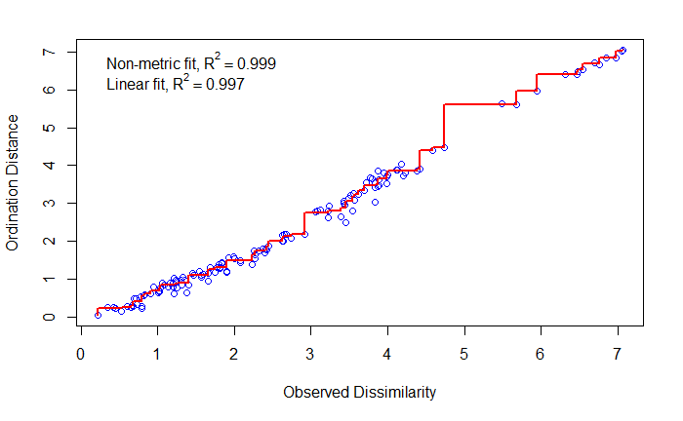
Notes:
Goodness of fit in Shepards diagram – pretty exceptionally well fitted

Slide 19
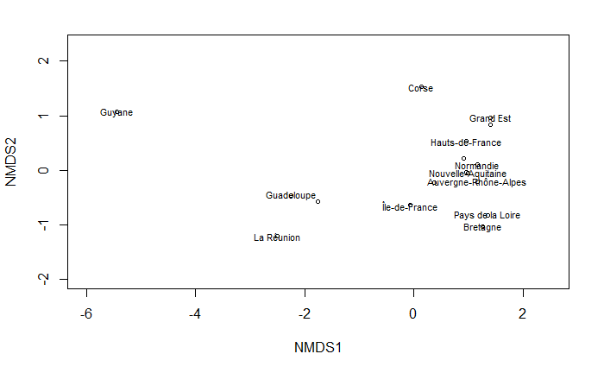
Notes:
A plot of individual regions in ordination space:
You can see that negative values of NMDS1 are associated with DOM observations while positive values of NMDS1 are associated with metropolitan France
The associations between the observations and NMDS2 are not as immediately clear

Slide 20
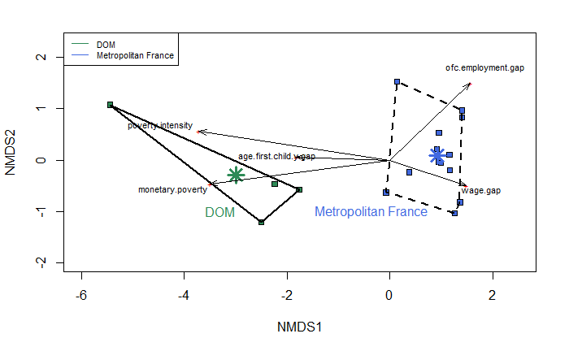
Notes:
In this ordination plot
Observations are color coded based on geographic region (DOM vs Metropolitan France)
DOM and Metropolitan France group centroids plotted as stars, and convex hulls around geographic region group point clusters
Variable scores vectors
NMDS1 negative = association to DOM, higher monetary poverty, age at first child gap, and instensity of poverty
NMDS1 positive = association to MET, higher wage gap %, higher employment gap % in official positions
NMDS2 positive = association to higher employment gap, suggests variation among metropolitan france group

Slide 21
Bibliography:
Andreas Alfons (2019). robustHD: Robust Methods for High-Dimensional Data. R, package version 0.6.1. https://CRAN.R-project.org/package=robustHD
Jari Oksanen, F. Guillaume Blanchet, Michael Friendly, Roeland Kindt, Pierre Legendre, Dan McGlinn, Peter R. Minchin, R. B. O'Hara, Gavin L. Simpson, Peter Solymos, M. Henry H. Stevens, Eduard Szoecs and Helene Wagner (2020). vegan: Community Ecology Package. R package version 2.5-7. https://CRAN.R-project.org/package=vegan
INSEE. “Indicateurs Régionaux Sur Les Inégalités Entre Les Femmes et Les Hommes | Insee.” Accessed June 2, 2021. https://www.insee.fr/fr/statistiques/2513786#consulter.
———. “Indicateurs Territoriaux de Développement Durable | Insee.” Accessed June 2, 2021. https://www.insee.fr/fr/statistiques/4505239#documentation.
———. “Nomenclatures Des Professions et Catégories Socioprofessionnelles | Insee.” Accessed June 2, 2021. https://www.insee.fr/fr/information/2497952.
“Data Analysis in the Geosciences.” Accessed June 2, 2021. http://strata.uga.edu/8370/lecturenotes/multidimensionalScaling.html.
Matthew E. Clapham. 29: Non-Metric Multidimensional Scaling (NMDS), 2016. https://www.youtube.com/watch?v=Kl49qI3XJKY.
“RPubs - Running NMDS Using MetaMDS in Vegan.” Accessed June 2, 2021. https://rpubs.com/CPEL/nmds.

